Slide 1
From patriarchal masculinities to transformative masculinities
Module 3

Slide 2
Where and How can transformation be brought about ?
Home
Workplace
Street

Slide 3
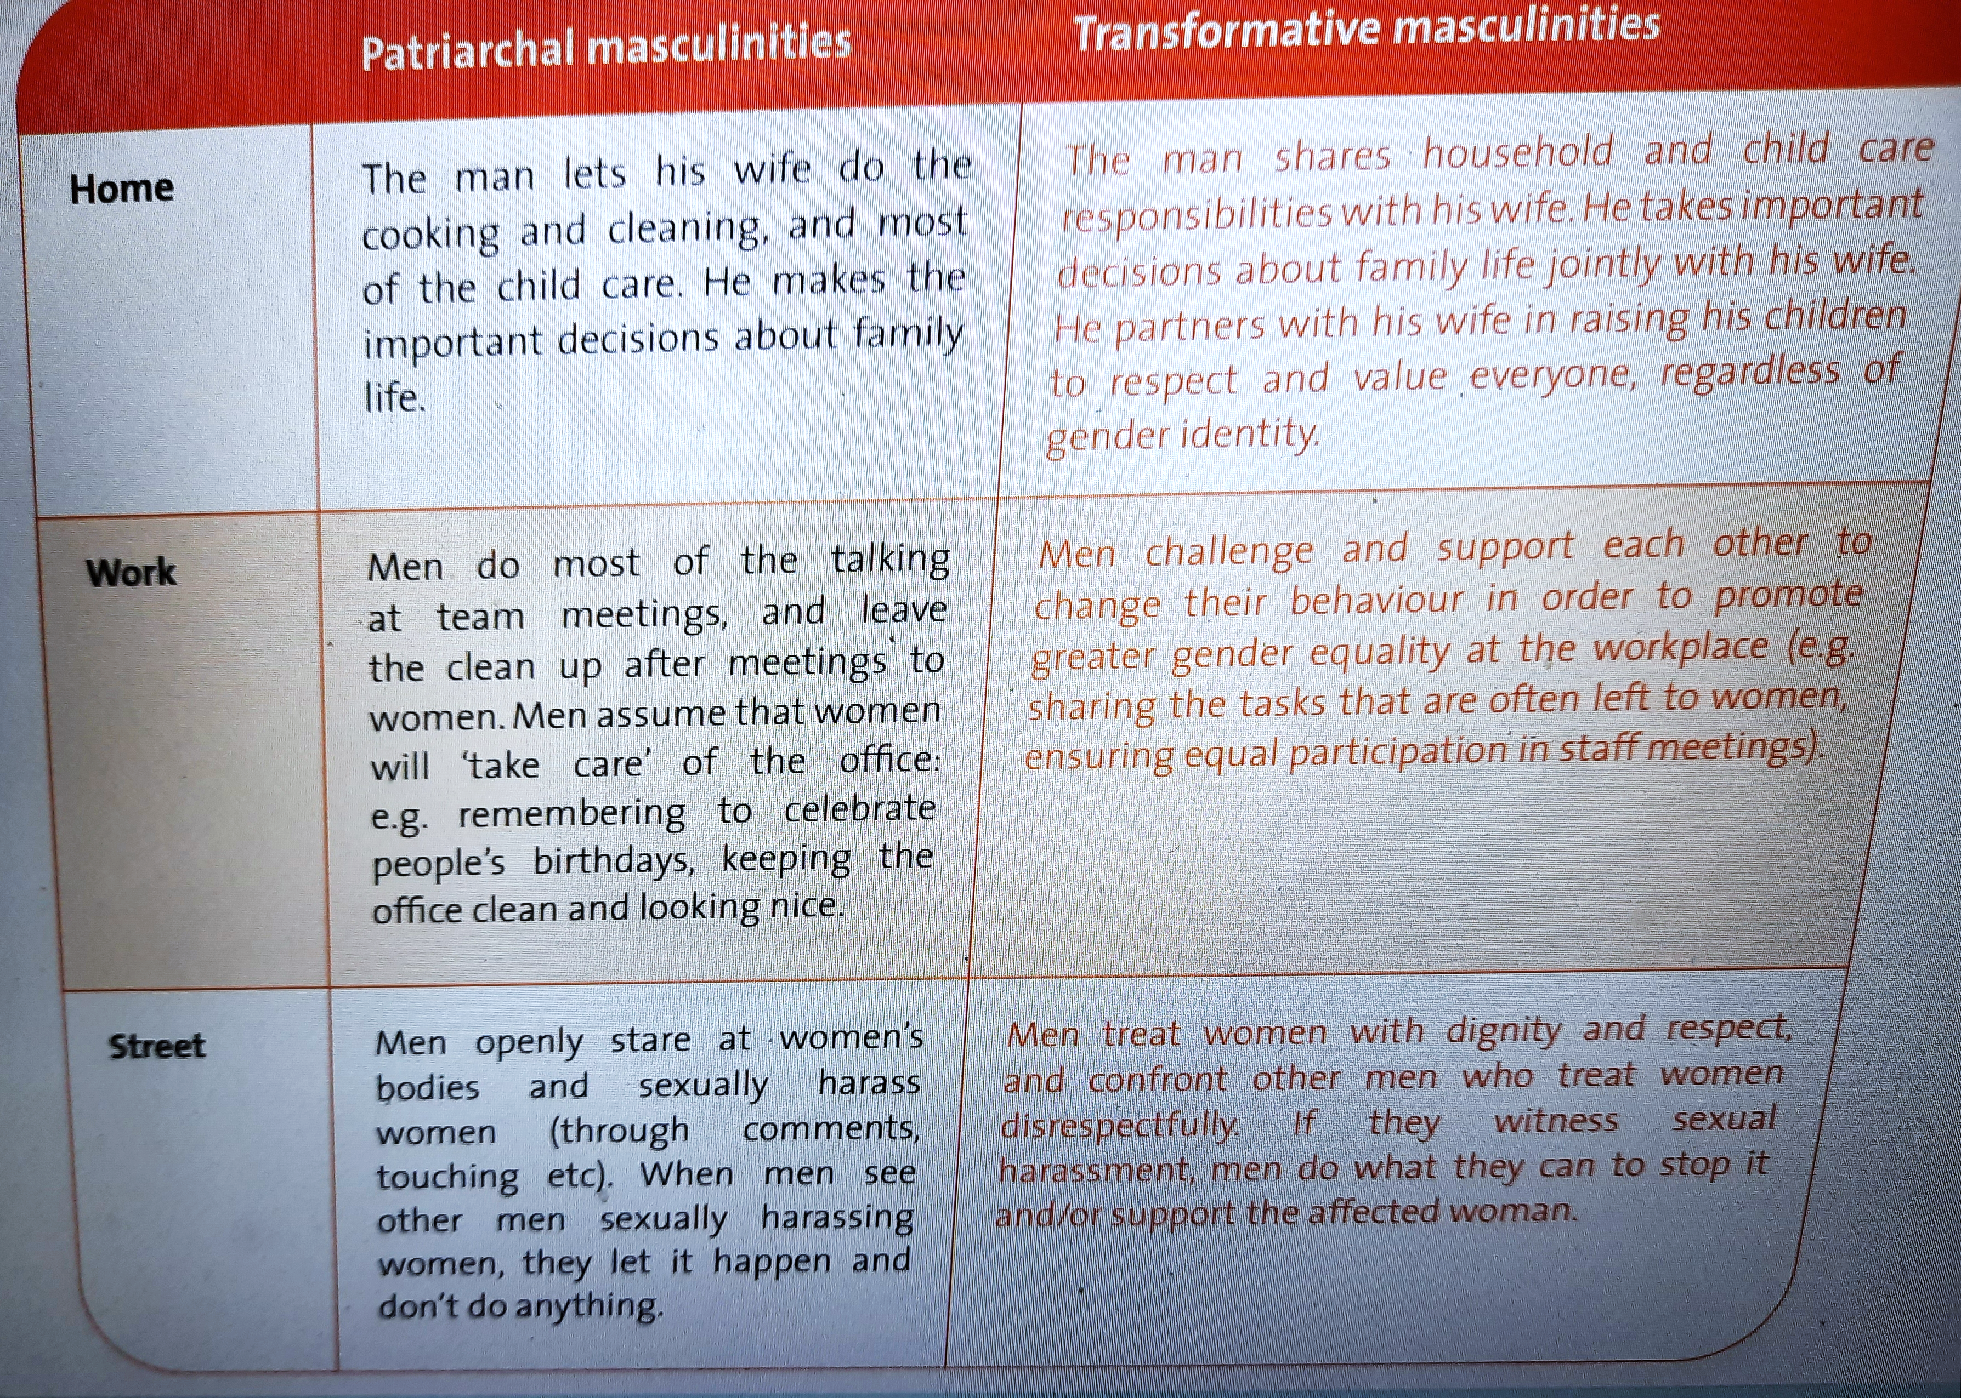
Source:
UN Women
http://www.endvawnow.org/

Slide 4
Typology of power
Patriarchal masculinity is an expression of ‘power over’ – dominance, authority, control
Transformative masculinities are expressions of
‘power to’,
‘power with’
‘power within’

Slide 5
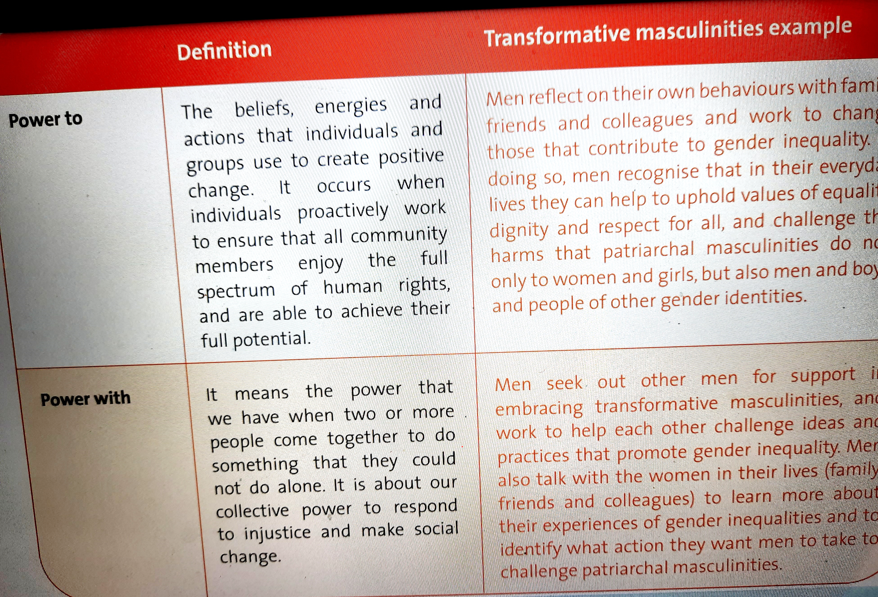

Slide 6
Please brainstorm and come up with at least three ideas of actions that you can take as an individual and/or as a student group to bring about a transformative, democratic culture in any domain

Slide 7

Thank you for your time and attention

